Slide 1



Reading Group
RegMixup: Mixup as a Regularizer Can Surprisingly Improve Accuracy & Out-of-Distribution Robustness
Shasha Zhou
Sun, May 21, 2023

Slide 2
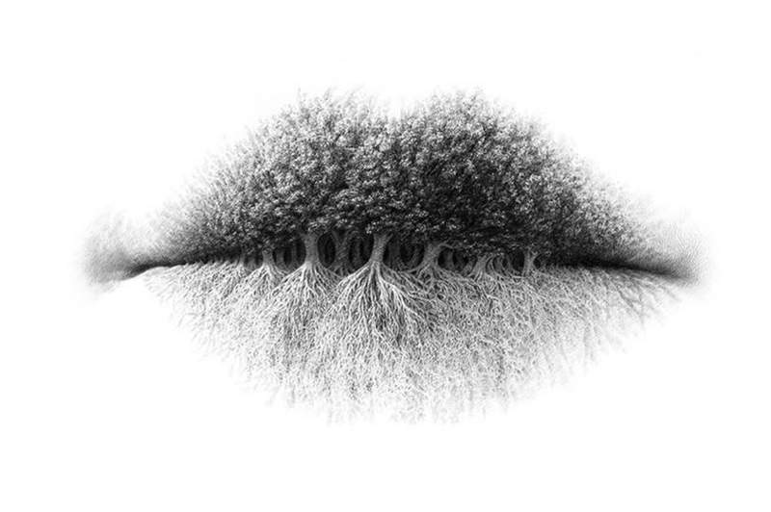

Noisy Labels
Examples
“moon” or “face”?
“lip” or “forest” or “tree root”?

Slide 3
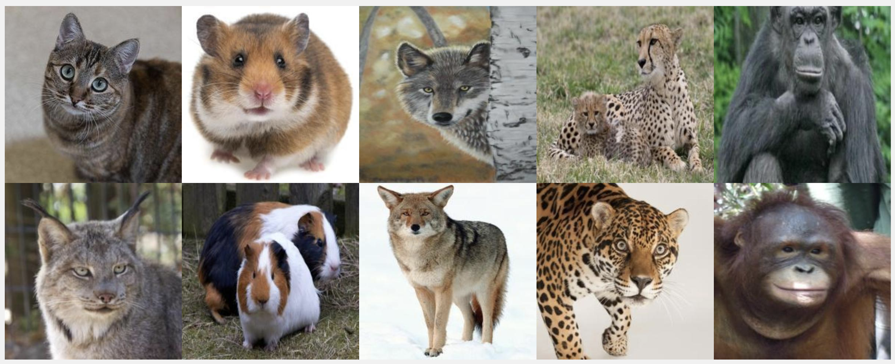
Noisy Labels
The ratio of corrupted labels in real-world datasets is reported to range from 8.0% to 38.5%.[1,2]
cat
hamster
wolf
jaguar
chimpanzee
lynx
Guinea pig
coyote
cheetah
orangutan
[1] K.-H. Lee et al., CleanNet: Transfer learning for scalable image classifier training with label noise,CVPR’18
[2] H. Song et al., SELFIE: Refurbishing unclean samples for robust deep learning , PMLR’19

Slide 4
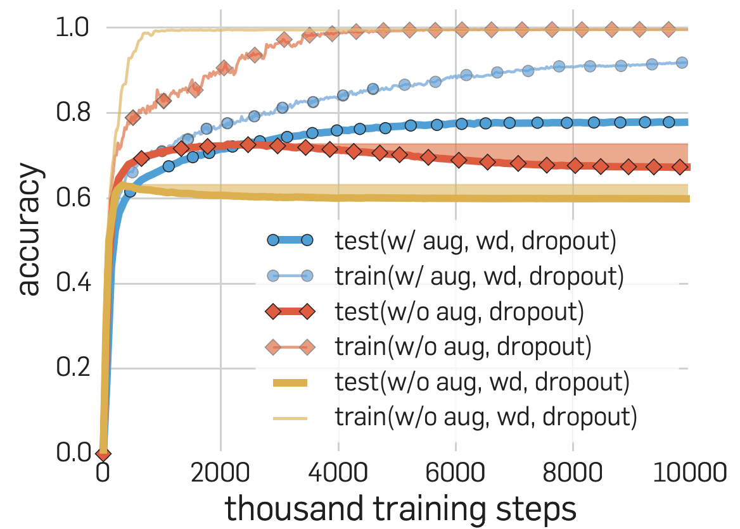
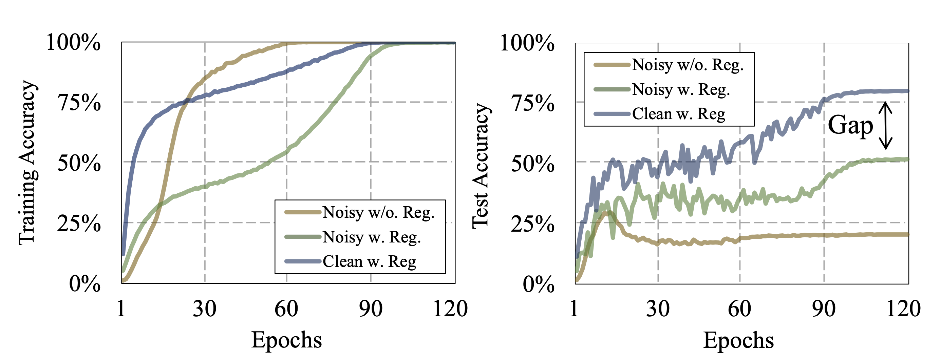
Noisy Labels
DNNs can easily fit an entire training dataset with any ratio of corrupted labels, which eventually resulted in poor generalizability on a test dataset.
Regularization: data augmentation, weight decay, dropout …
Fig1. Effects of implicit regularization on generalization performance.
Fig2. Convergence curves of training and test accuracy when training WideResNet-16-8 using a standard training method on the CIFAR-100 dataset with the symmetric noise of 40%.

Slide 5
Noisy Labels
Classification
Instance-independent label noise
Assume the corruption process is conditionally independent of data feature
noise transition matrix , where
a “dog” is more likely to be confused with a “cat” than with a “fish.”
Instance-dependent label noise

Slide 6
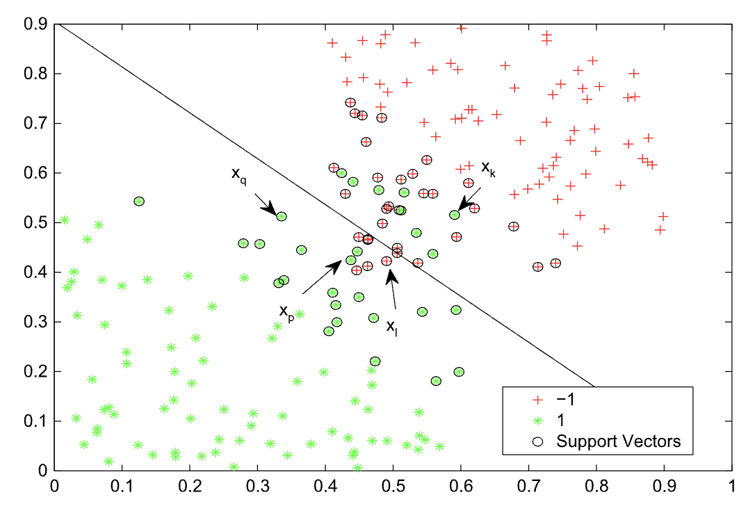
Noisy Labels
Non-deep Learning Approaches
Data Cleaning: excluding examples whose labels are likely to be corrupted
Bagging or boosting methods: remove examples with higher weights because false-labeled examples tend to exhibit much higher weights than true-labeled examples
k-nearest neighbour, outlier detection, and anomaly detection
overly removes even the true-labeled examples
Surrogate Loss (0-1 loss function)
use convex loss function to approximate the 0-1 loss function
cannot support the multi-class classification task
Probabilistic Method
the distribution of features is helpful in solving the problem of learning from noisy labels
Estimate each label’s confidence (convert hard label into soft label)
exacerbate the overfitting issue (increased number of
model parameters)
Model-based Method
Penalize the mis-classified examples
Infeasible to apply these methods to deep learning

Slide 7
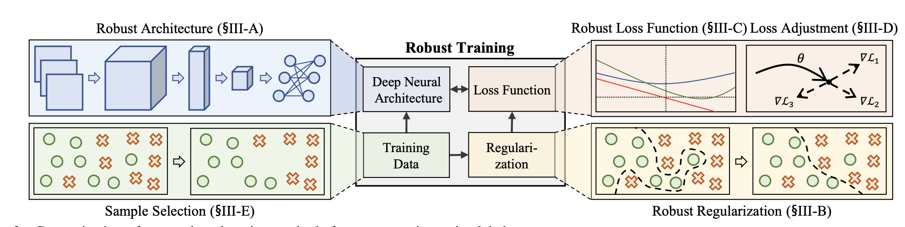
Noisy Labels
A high level research overview of robust deep learning for noisy labels
Robust Architecture: adding a noise adaption layer at the top of an underlying DNN to learn label transition
Robust Regularization: enforcing a DNN to overfit less to false-labeled examples explicitly or implicitly
Robust Loss Function: improving the loss function
Loss Adjustment: adjusting the loss value according to the confidence of a given loss(or label) by loss correction, loss reweighting, or label refurbishment
Sample Selection: identifying true-labeled examples from noisy training data via multi-network or multi-round learning.

Slide 8
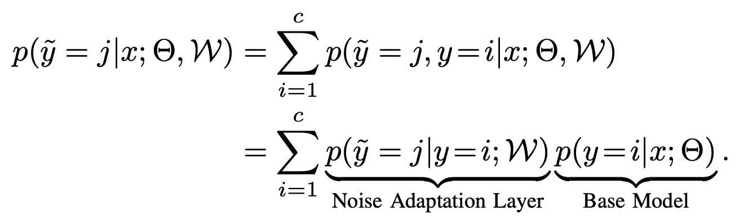
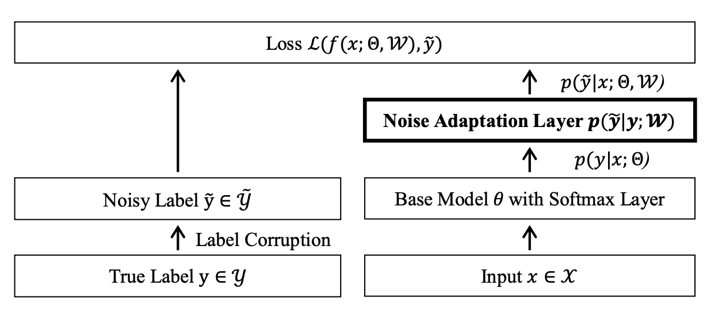
Noisy Labels
Robust Architecture
Discovering the underlying label transition pattern
mimic the label transition behaviour in learning a DNN

Slide 9
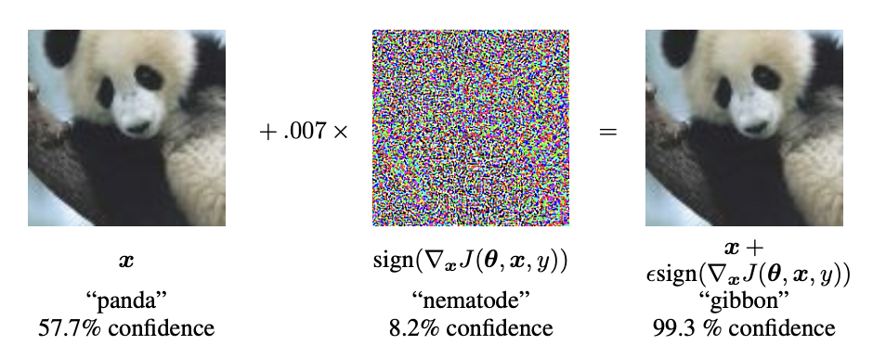
Noisy Labels
Robust Regularization (imporve the generalization)
Explicit Regularization
bilevel learning:
use a clean validation dataset to regularize the overfitting
Adjust the weights on each mini-batch and selecting their values to minimize the error on the validation dataset
Pre-training:
Fine-tuning on a pre-trained model provides a significant improvement in robustness compare with models trained from scratch
Implicit Regularization
Adversarial training
Label smoothing
mixup

Slide 10
Mixup
Motivation[1]
Empirical Risk Minimization (ERM)
Finding a function that describes the relationship between a random feature vector and a random target vector
The distribution P is unknown in most practical situations.
Use a set of training data to approximate
We can approximate the expected risk by the empirical risk
Problem: memorization /overfitting[2]
[1] Hongyi Zhang et al., mixup: BEYOND EMPIRICAL RISK MINIMIZATION, ICLR’18
[2] C. Szegedy et al., Intriguing properties of neural networks, ICLR’14

Slide 11
Mixup
Motivation
Vicinal Risk Minimization (VRM)[1]
sample the vicinal distribution to construct a dataset
Minimize the empirical vicinal risk
Enlarge the support of the training distribution
For instance: horizontal reflections, slight rotations, and mild scaling on image
Shortcoming
Dataset-dependent
Require the use of expert knowledge
[1] Oliver Chappelle et al., Vicinal Risk Minimization, NeurIPS’00

Slide 12
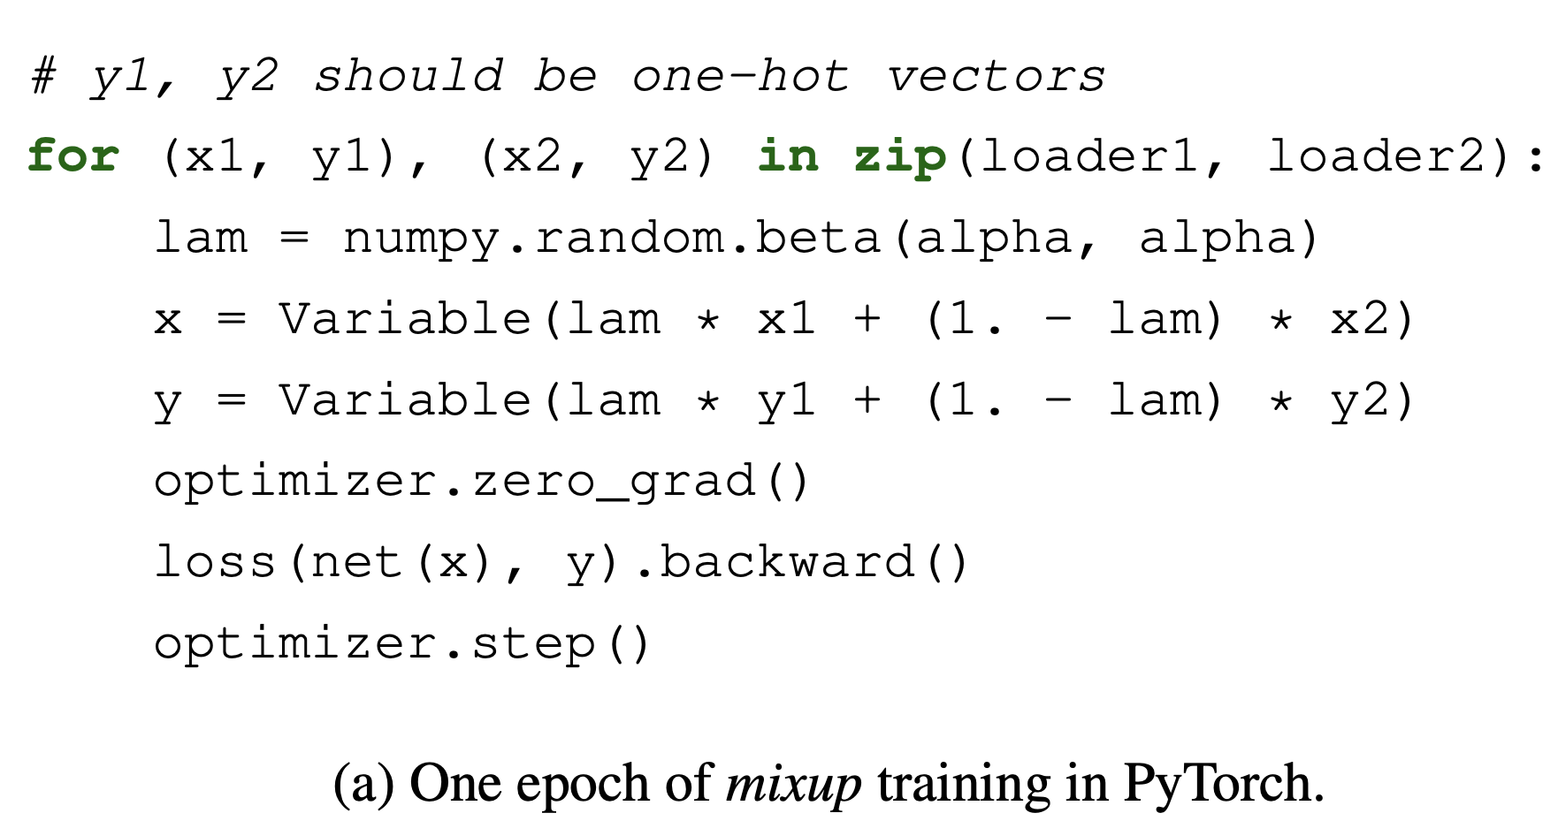
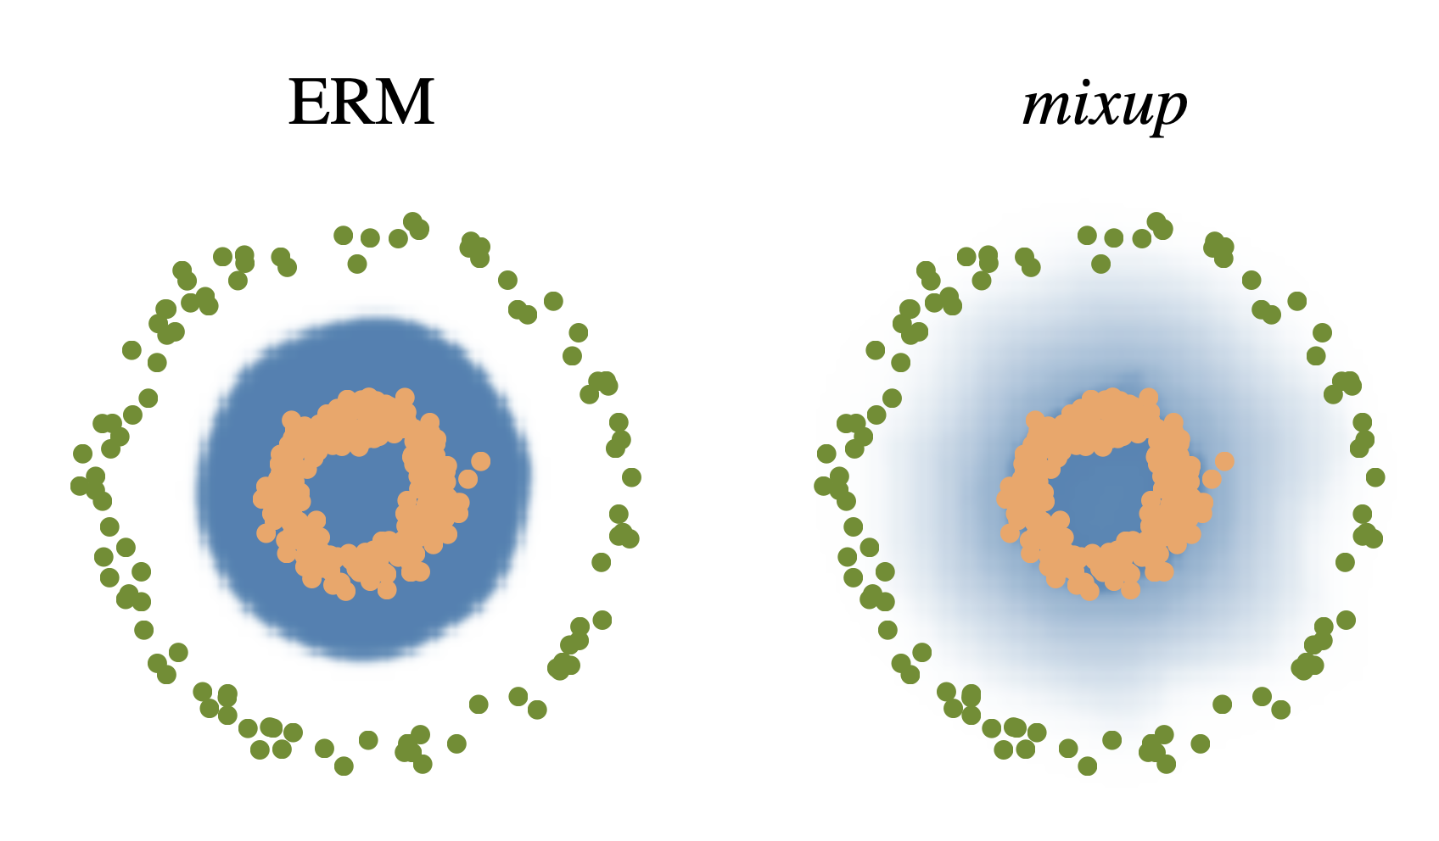
Mixup
Introduce a simple and data-agnositic data augmentation routine, termed mixup.

Slide 13
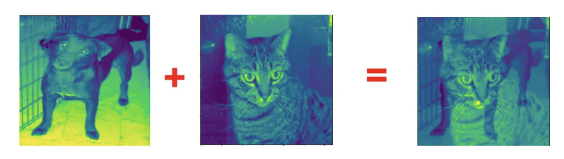
Mixup
Example
Input
Dog 0
Cat 1
Label
The picture has a 70% chance of being classified as a cat, and a 30% chance of being classified as a dog

Slide 14
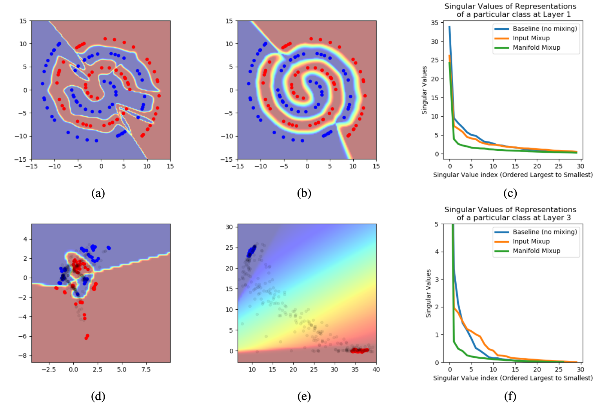
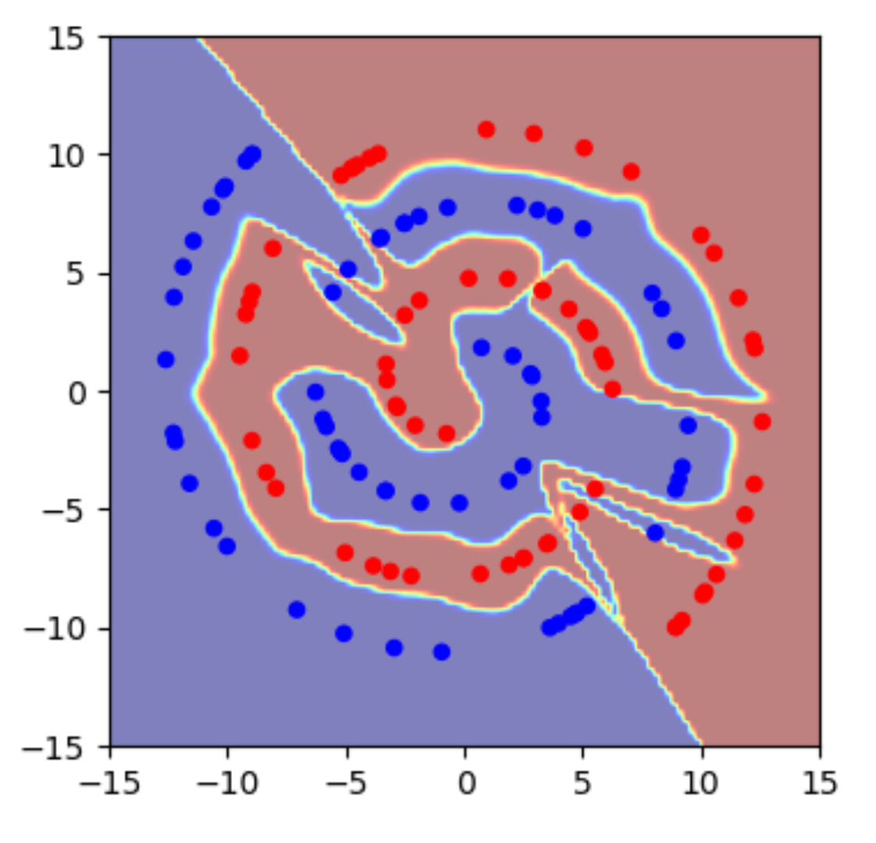
Manifold Mixup
Mainfold Mixup
[1] Vikas Verma et al., Manifold Mixup: Better Representations by Interpolating Hidden States, PMLR’19

Slide 15
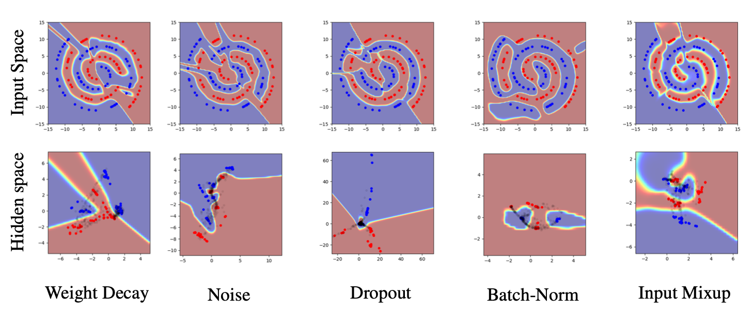
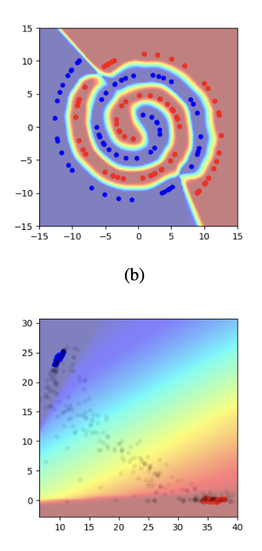
Manifold Mixup
Manifold Mixup

Slide 16
Manifold Mixup
Consider training a deep neural network , where denotes the part of the neural network mapping the input data to the hidden representation at layer , and denotes the part mapping such hidden representation to the output .

Slide 17
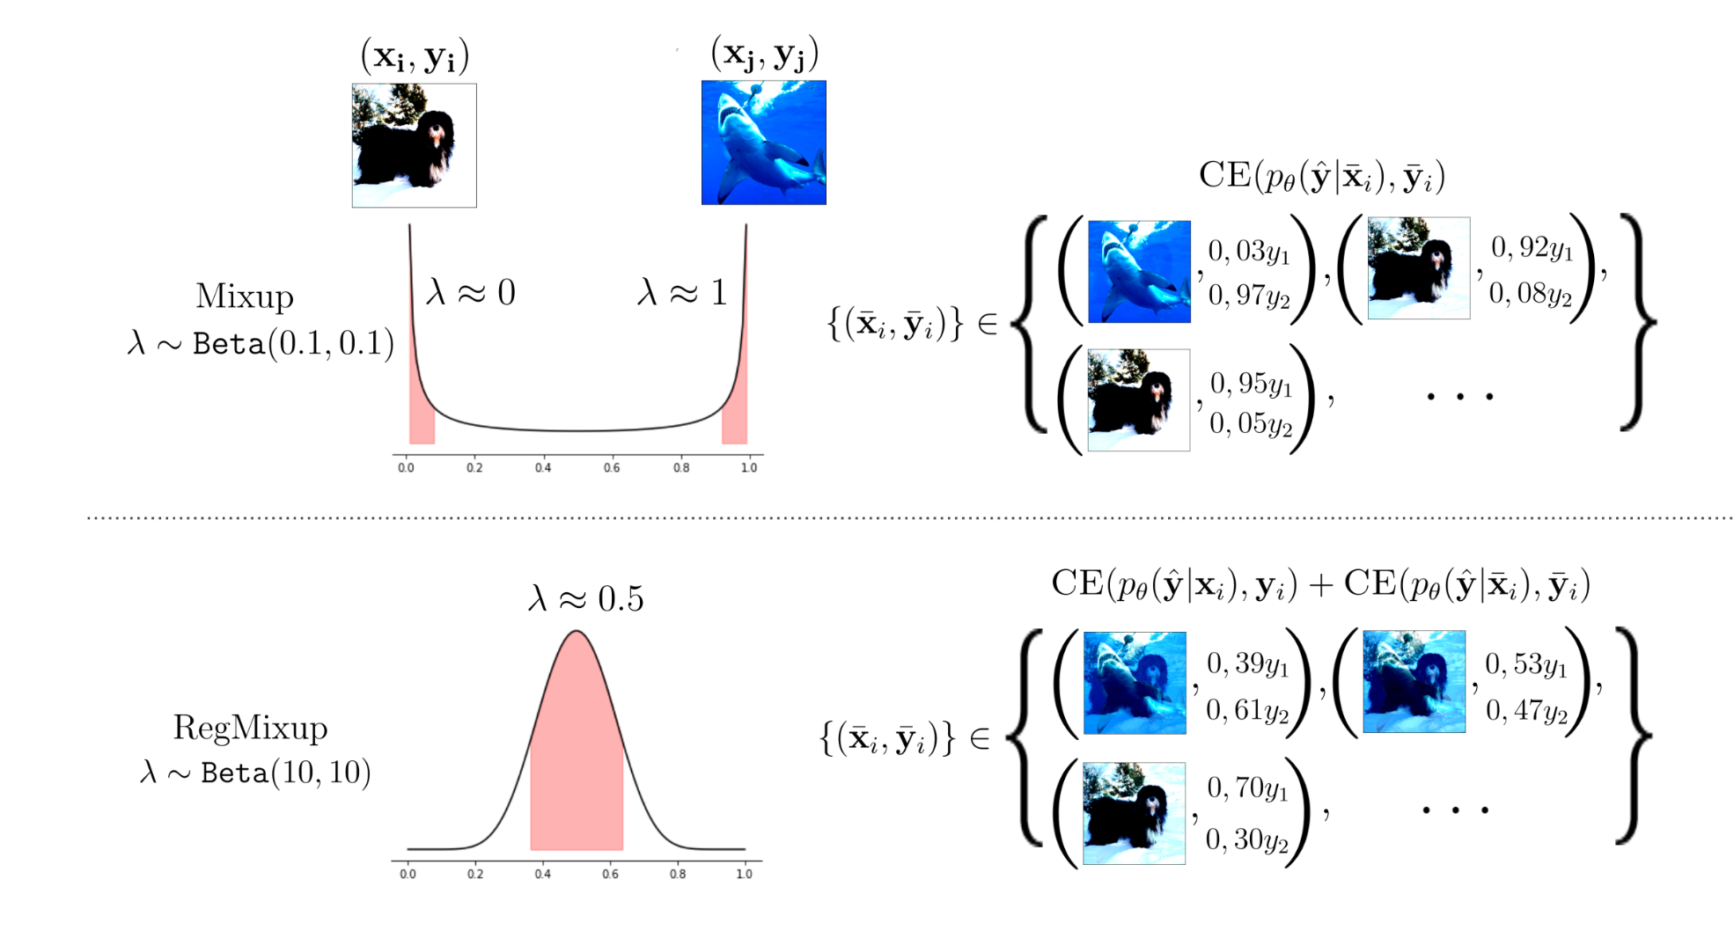
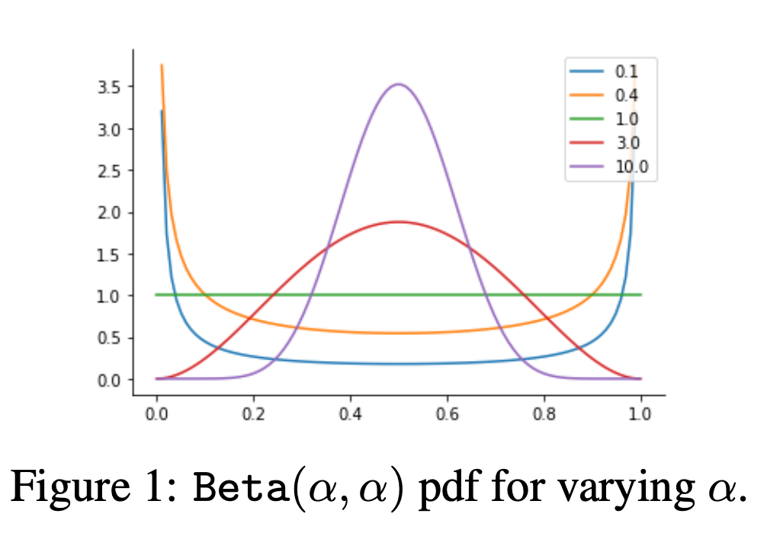
Reg-mixup
Small cross-validated
High-entropy behaviour
Reason:
Augumentation is not strong enough
The model has only seen the mixed labels
[1] Francesco Pinto et al., RegMixup: Mixup as a Regularizer Can Surprisingly Improve Accuracy & Out-of-Distribution Robustness, NeurIPS’22

Slide 18
Reg-mixup
Data distribution
Loss function

Slide 19
RegMixup
how the cross-validated affects the shape of the Beta distribution in both cases.

Slide 20
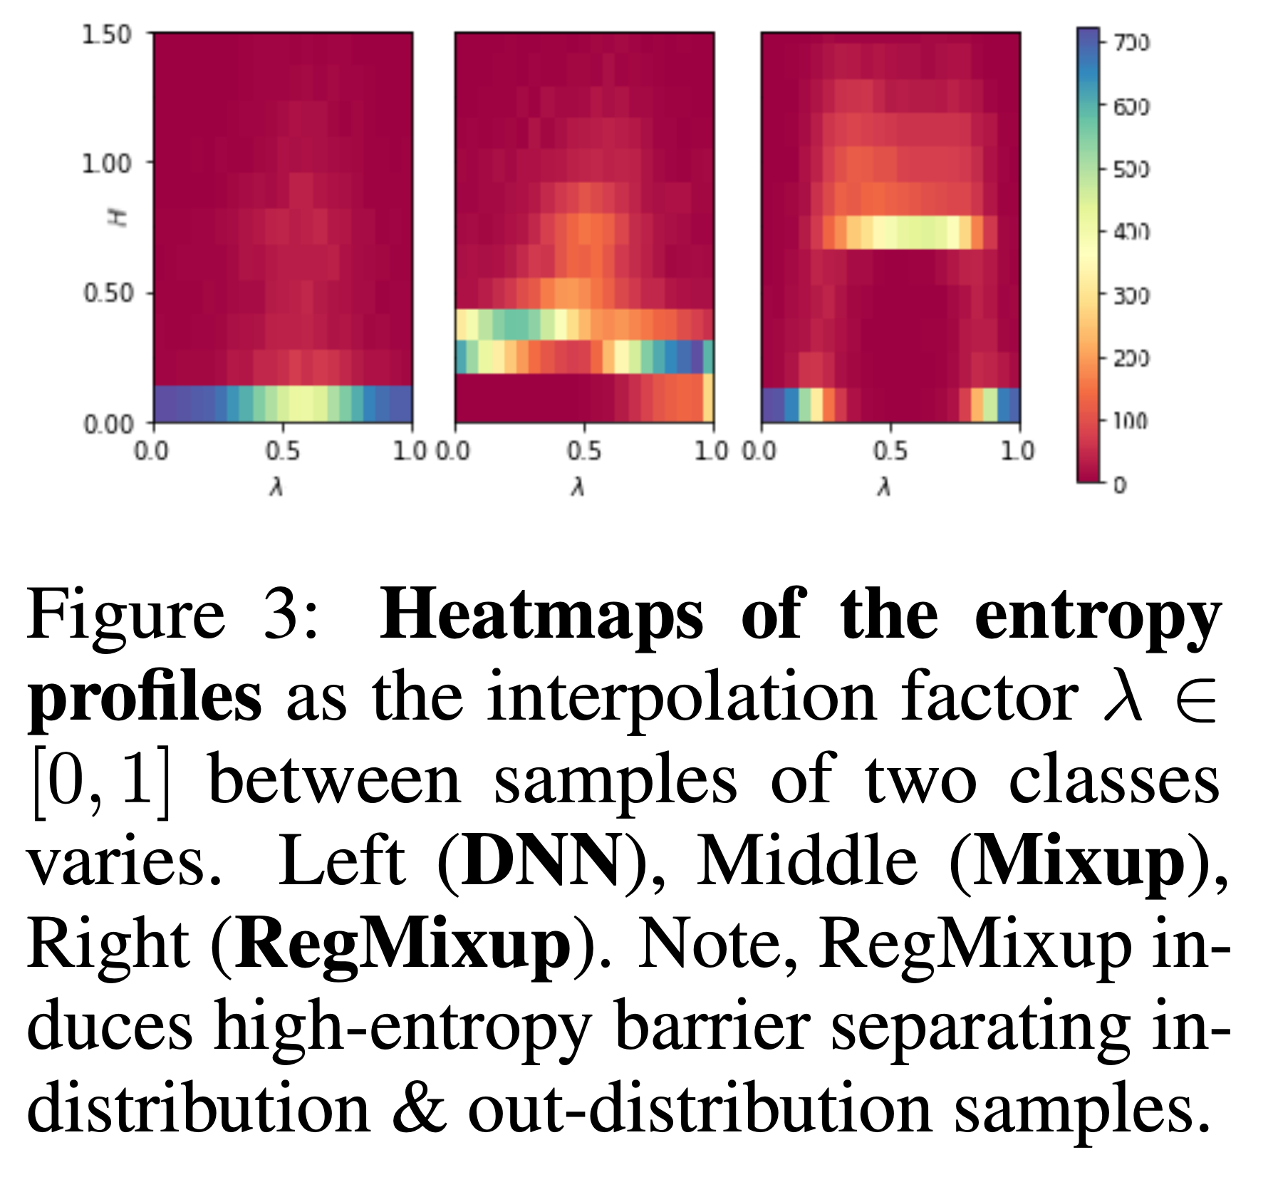
RegMixup
Maximizing a soft proxy to entropy(knowingly unknowing the unknown)

Slide 21
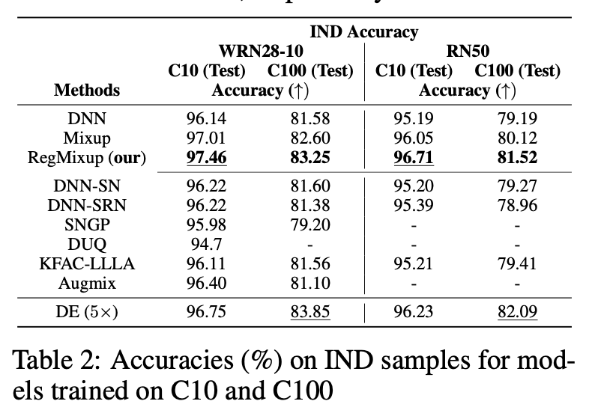
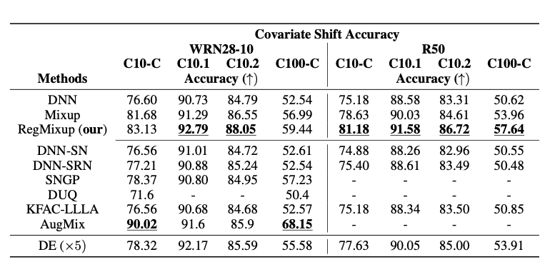
RegMixup
RegMixup Improves Accuracy on In-distribution and Covariate-shift Samples
Small-scale (CIFAR) Experiments on In-distribution Data
Small-scale (CIFAR) Covariate Shift Experiments
Large-scale (ImageNet-1K) Experiments on in-distribution Data
Large-scale (ImageNet-1K) Covariate Shift Experiments

Slide 22
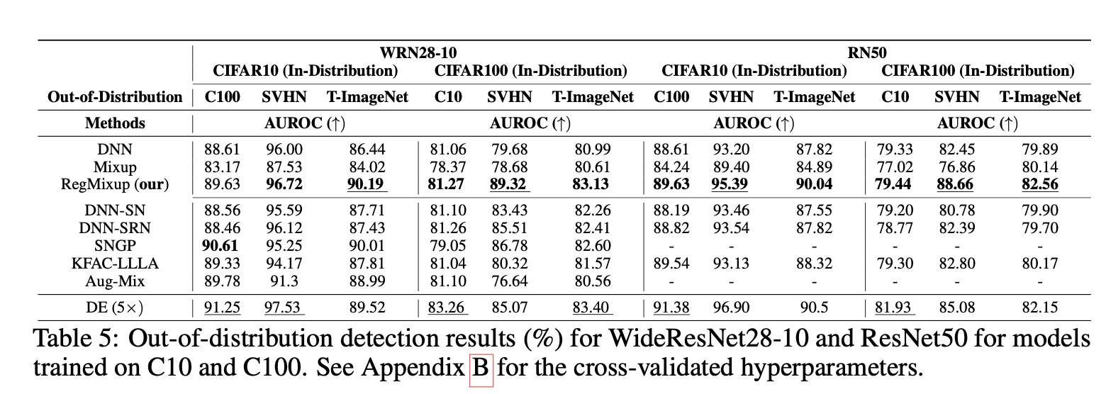
RegMixup
Out-of-Distribution Detection Experiments

Slide 23
Conclusion
Mixup & RegMixup:
Regularization: Mixup and RegMixup are extremely good at regularizing ML models for Computer Vision tasks.
Simplicity and speed
A question: how to use these trick on discreate data, text, code…?
An idea
Understanding the connection between input perturbation and label noise/ adversarial example and noisy label
From an input perspective: add a noise to mislead neural network
From an label perspective: adversarial example is a mislabeled example
We can analyze whether adversarial example is instance-independent label noise or instance-dependent label noise

